Slide 1
Space Apps Chile
Asteroid Hunting - Team Tuor
The Challenge
Develop a mission concept to explore Apophis (or any other significant asteroid) to better predict its orbital dynamics and to instrument the object with a radio transponder prior to the 2029 close approach. Team 10: Tuor
Carlos Aguilera, Rodolfo Novakovic, Erik Vallejos, Anton Rabanus, David Rabanus

Slide 2
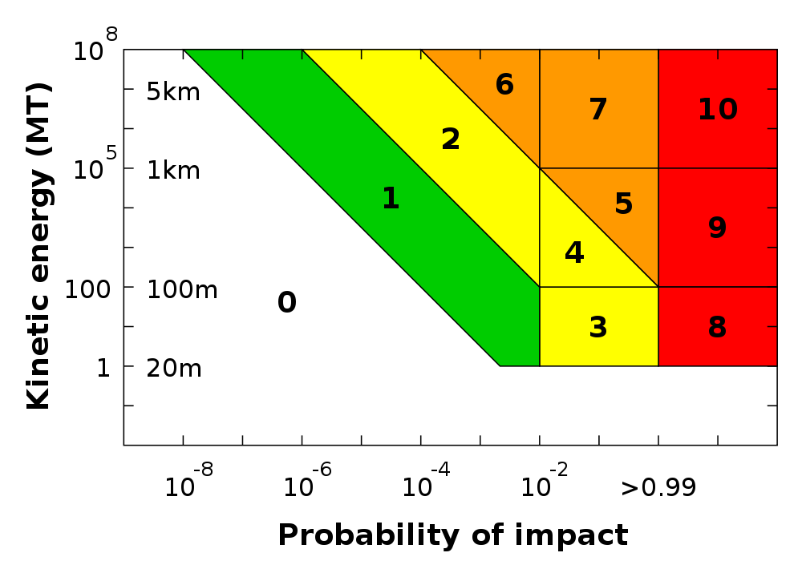
The Torino Scale: Risk assessment

Slide 3
Ideas, Details
Tagging and tracking of only one asteroid (this challenge) does not make sense when there are >100.000 unknown objects in the asteroid belt that potentially can pose a risk to life on earth and require to be tracked.
For a better orbit prediction it is required to know the forces that act on an asteroid.
To calculate these forces, position and velocity vector of each of the objects need to be obtained
Learning from the concept of WISE (NASA mission from 2010/2011, and continuing the observations.

Slide 4
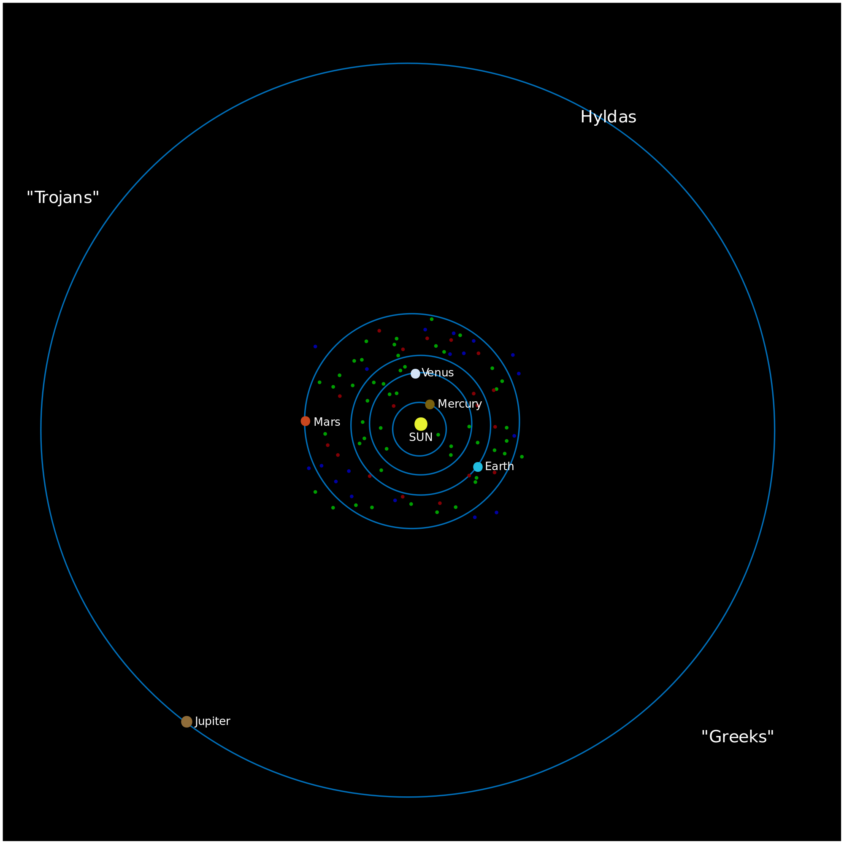
The Situation:
A daunting Challenge

Slide 5
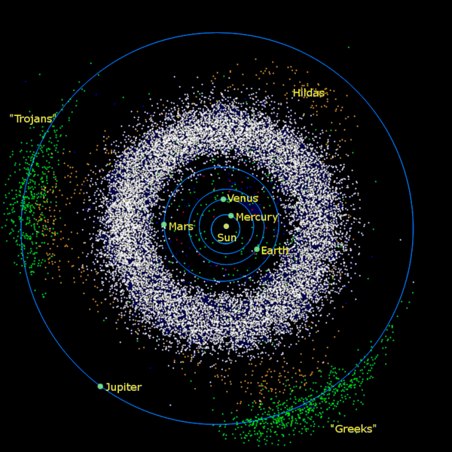
The Situation:
A daunting Challenge

Slide 6
Interplanetary Mission Description Platform
Lagrange-2 orbit at Mars: Half way to the Main Asteroid Belt (4x more signal!)
CubeSat (Ardusat!) platform, 3U form factor
Hitching a ride to Mars (~150kg ballast load)
Swarm (“enjambre”) de >4 replicas
Miniaturized ion thrusters for propulsion from Mars to L2@Mars, and attitude control
Power from solar panels
Telemetry/downlink via amplified CubeSat system

Slide 7
Interplanetary Mission Description Scientific Equipment
Rotation-cone-scanning thermal IR telescope
3x cell-phone CCD as star trackers
Linux on-board processing of images (“stacking”) and data reduction
200mm space-foldable telescope
11 and 19 arcsec resolution
2x Peltier-cooled microbolometer arrays
10µm and 18µm color channels: main emission wavelength of asteroids

Slide 8
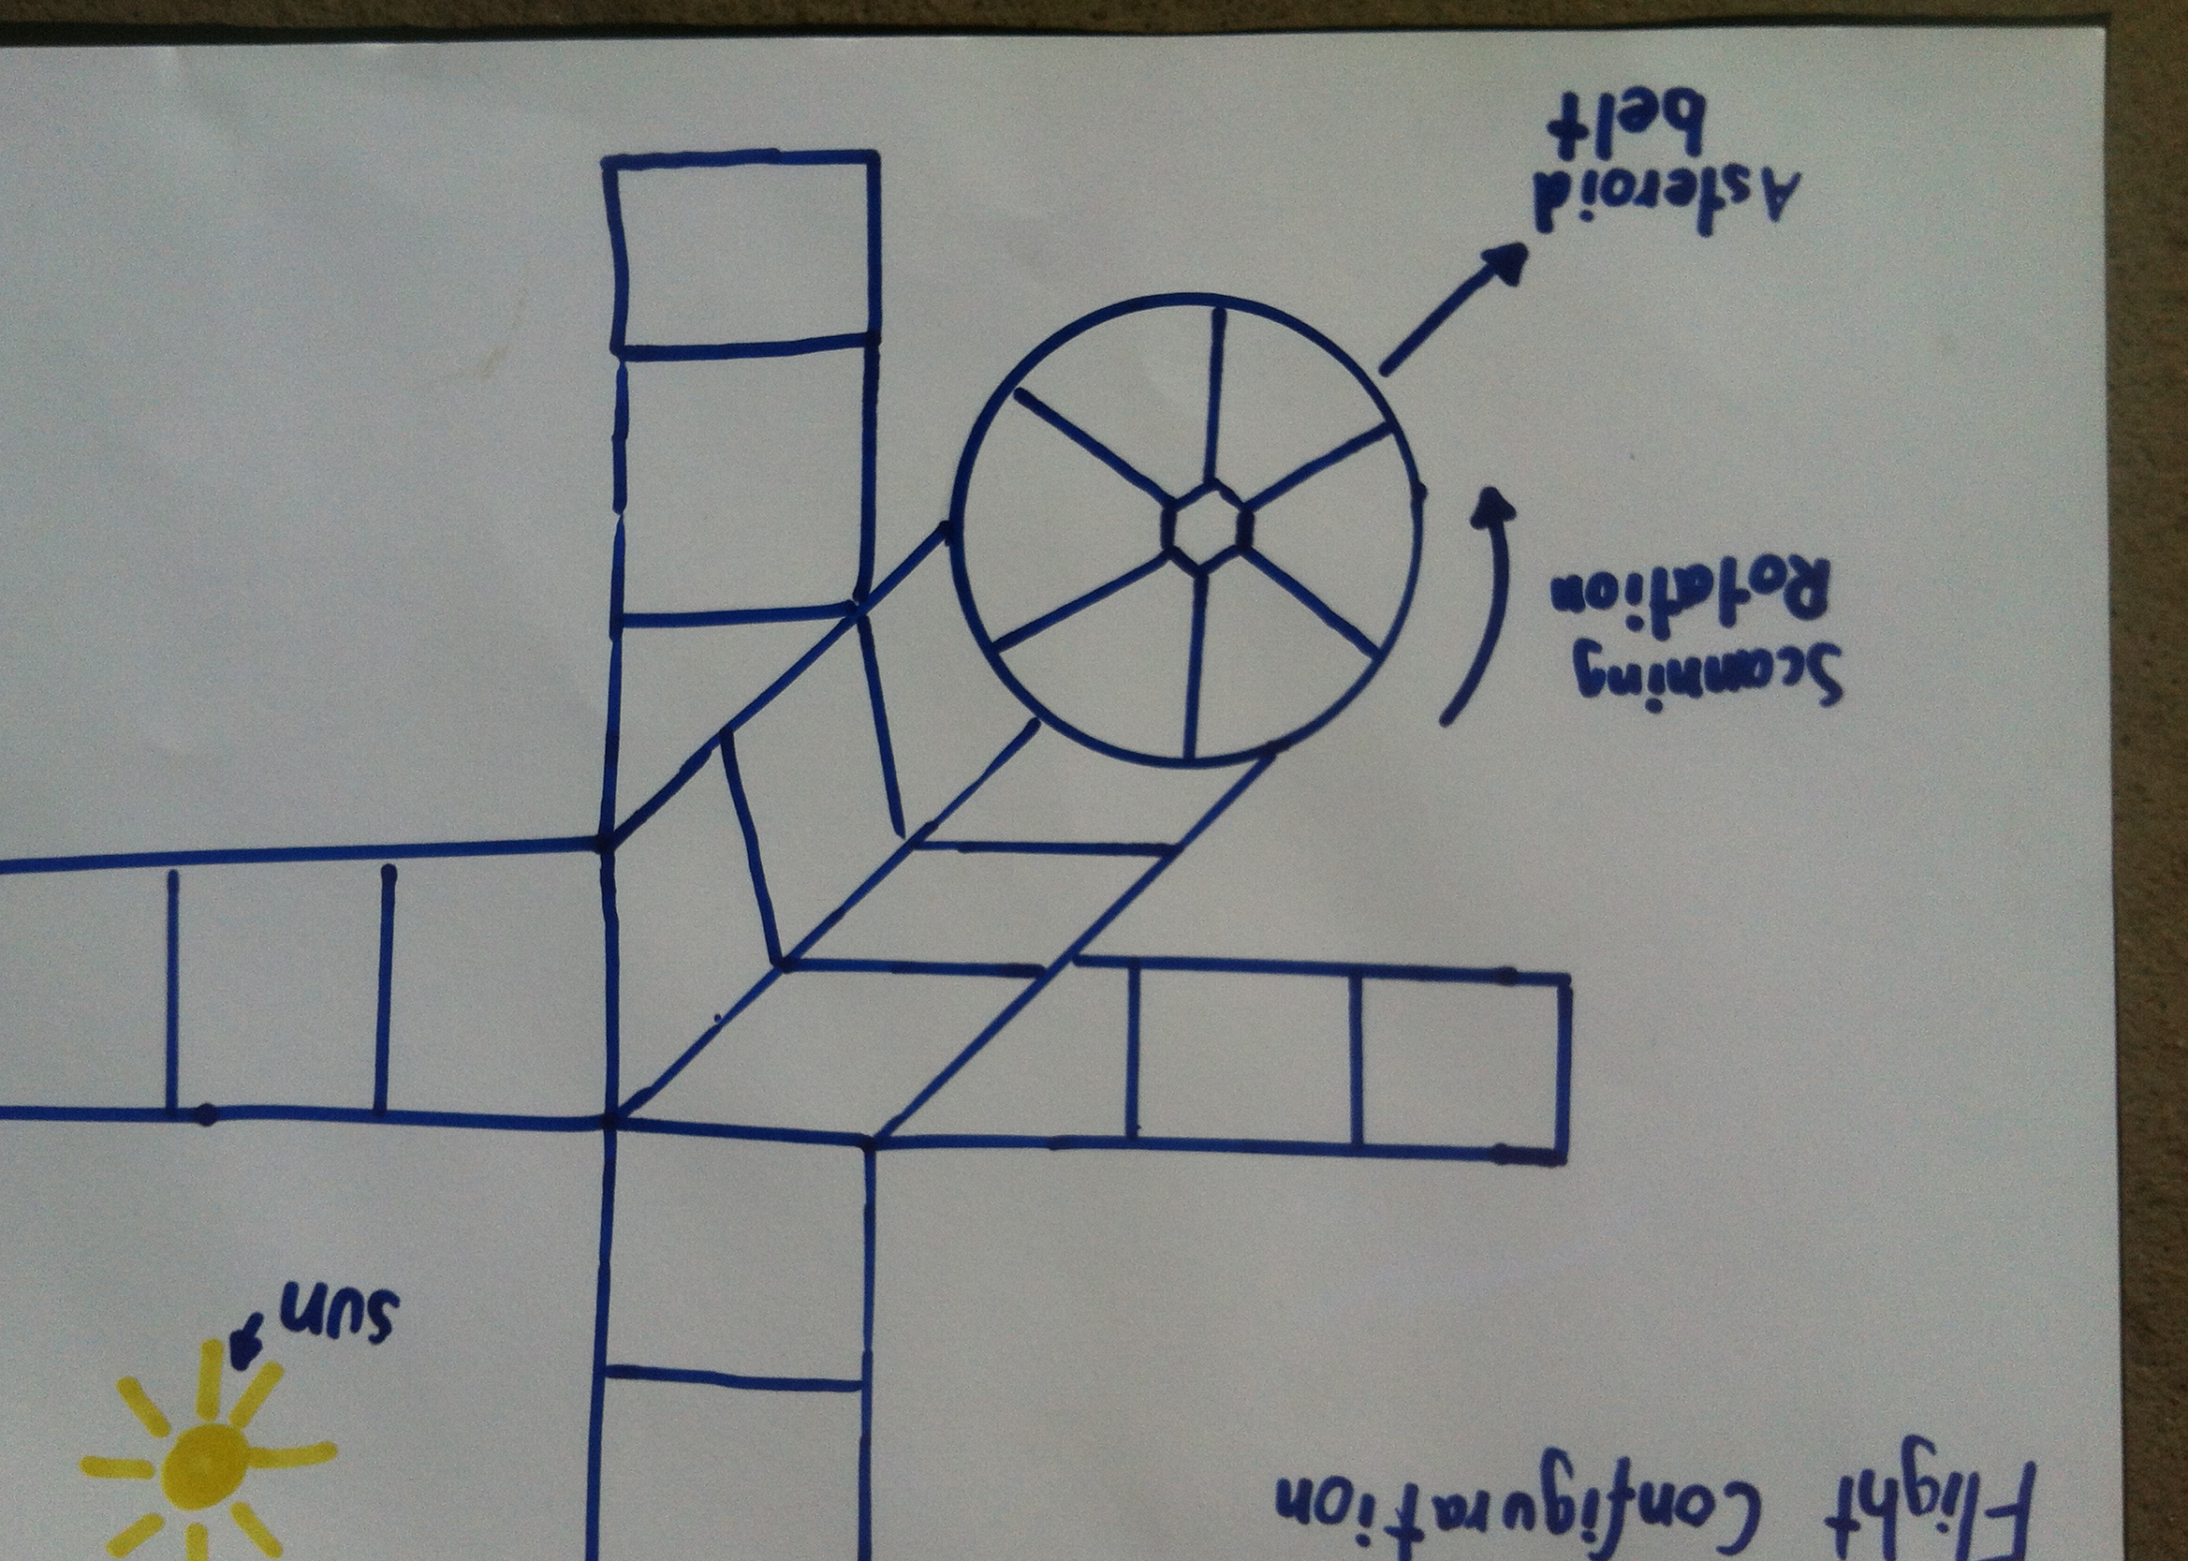
Flight Configuration

Slide 9
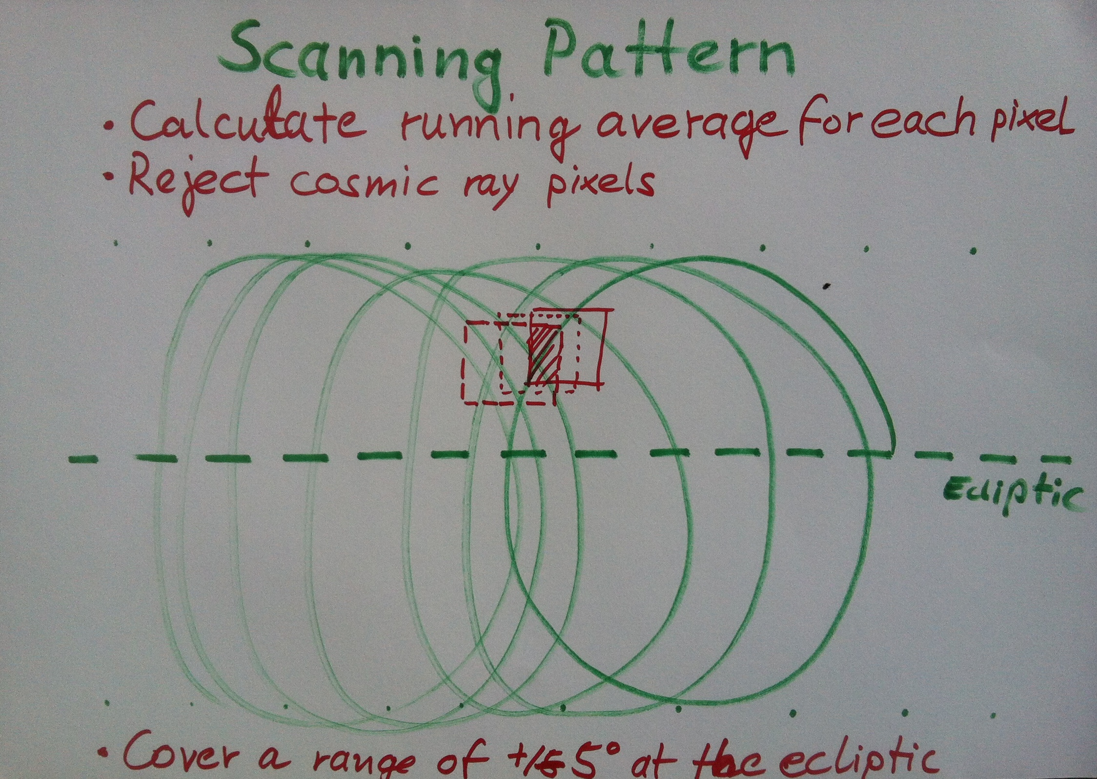
Scanning Geometry

Slide 10
Interplanetary Mission Description Results
Download through amateur deep space network
Post-processing at earth-bound facilities:
Checking of data quality
Incentive optical follow-up observations (validation)
Ingest orbital parameters of found asteroids into JPL database
Calculate proximity values to Earth orbit
Visualization via web-based access to database

Slide 11
Synergies with other
Space Apps Challenges
Database for NEO (Near Earth Objects):
#NEOdatabase
CubeSats for Asteroid Exploration:
#cubesats
Ardusat:
#ardusat
Hitch a ride to Mars:
#ridetomars
Why We Explore:
#whyweexplore

